Slide 1
Compiler Design 14CS73 Unit II: Syntax Analysis
Dr. Saroja Devi

Slide 2
Role of a Parser (syntax analyser)
Parser for any grammar is a program that takes as input string w (obtain set of strings tokens from the lexical analyzer) and produces as output either a parse tree for w , if w includes valid sentences of grammar, or error message indicating that w is not a valid sentence of given grammar.
The goal of the parser is to determine the syntactic validity of a source string, and to build a tree for use by the subsequent phases of the computer. The tree reflects the sequence of derivations or reduction used during the parser. Hence, it is called parse tree.
If string is invalid, the parser has to issue diagnostic message identifying the nature and cause of the errors in string. Every elementary subtree in the parse tree corresponds to a production of the grammar.
Example grammar
S → cAd
A → ab | a
Notes:
In our compiler model, the parser obtains a string of tokens from the lexical
analyzer, as shown in Fig. 4.1, and verifies that the string of token names
can be generated by the grammar for the source language. We expect the
parser to report any syntax errors in an intelligible fashion and to recover from
commonly occurring errors to continue processing the remainder of the program.
Conceptually, for well-formed programs, the parser constructs a parse tree and
passes it to the rest of the compiler for further processing.

Slide 3
Operations of a parser
Parser obtains a string of tokens from the lexical analyser, parses inputs one symbol at a time.
Verifies that given string of token names can be generated by the grammar for the source language.
Parser reports syntactic errors.
Helps recover from commonly occurring errors.
Generates parse tree for well formed programs.
Sends the parse tree to the next phase of compiler for further processing.
Constructs syntax directed translators also.

Slide 4
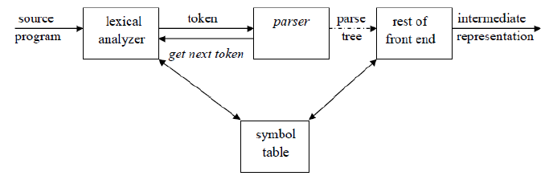
Parsing
Role of a parser
There are two ways of identifying an elementary subtree:
1. By deriving a string from a nonterminal
2. By reducing a string of symbol to a nonterminal.
Types of parsers :
Universal parser: Cocke Younger Kasami parser; Earley’s parser : inefficient
Top down parser: builds parse trees from top(root) to bottom(leaves)
Bottom up parser: builds parse trees from leaves and work up the root.

Slide 5
Syntax Errors & handling
Planning the error handling from the beginning is done by compiler designer. Parsing methods can detect syntactic errors efficiently.
Common programming errors can occur at many different levels.
• Lexical errors include misspellings of identifiers, keywords, or operators, e.g., the use of an
identifier elipseSize instead of ellipseSize and missing quotes around text intended as a string.
Misspelling an identifier, keyword, and operator are basically addressed.
• Syntactic errors include misplaced semicolons or extra or missing braces; that is, "{" or " } . " In C or Java, the appearance of a case statement without an enclosing switch is a syntactic error. (However, this situation is usually allowed by the parser and caught later in the processing, as the compiler attempts to generate code). Unbalanced parenthesis in expressions is
handled.
• Semantic errors include type mismatches between operators and operands. An example is a return statement in a Java method with result type void. Operator on an incompatible operand is an example.
• Logical errors can be anything from incorrect reasoning on the part of the programmer to the use in a C program of the assignment operator = instead of the comparison operator ==. The program containing = may be well formed; however, it may not reflect the programmer's intent. Infinite recursive calls are considered as logical errors. Parser may not handle this.

Slide 6
Error handling
Objectives of the error handler in a parser (challenging):
• Report the presence of errors clearly and accurately.
• Recover from each error quickly enough to detect subsequent errors.
• Add minimal overhead to the processing of correct programs.
Error recovery strategies:
Panic mode recovery: With this method, on discovering an error, the parser discards input symbols one at a time until one of a designated set of synchronizing tokens which are delimiters, such as semicolon or}, whose role in the source program is clear and unambiguous
Phrase level recovery: local correction by replacing a comma by a semicolon, delete an extraneous semicolon, or insert a missing semicolon
Error Productions: By anticipating common errors, the grammar is augmented for the language at hand with productions that generate the erroneous constructs. Anticipated errors are detected and the parser can then generate appropriate error diagnostics about the erroneous construct that has been recognized in the input.
Global corrections: make globally least cost correction; changing incorrect input x into y can be done with global transformations.
Notes:
Phase level recovery: Its major drawback is the difficulty it has in coping with situations in which the actual
error has occurred before the point of detection

Slide 7
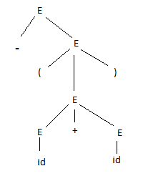
Parse Tree
A parse tree can be seen as a graphical representation of a derivation.
Root is labeled by the start symbol.
Inner nodes of a parse tree are nonterminal symbols.
The leaves of a parse tree are terminal symbols, each leaf is labeled by token or ϵ
Ex: representative grammar
G : E → E+E | E*E | ( E ) | - E | id
and
To parse: -(id+id)
Parse tree for – (id+id)

Slide 8
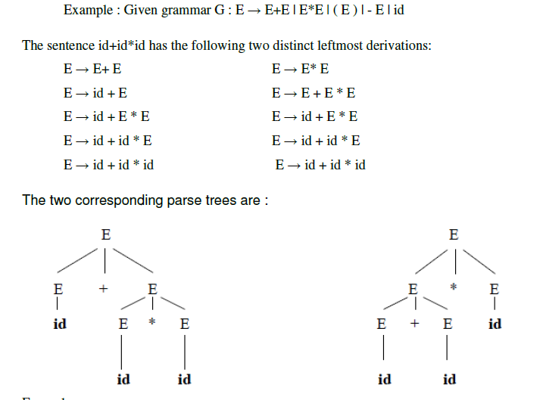
Ambiguity in grammar
Note: Left recursion & dangling else are the reasons for ambiguity. To disambiguate, use precedence of operators, or rewrite using method of eliminating left recursion or left factoring
Start with +
Start with *
A grammar that produces more than one parse tree for some sentence is said to be ambiguous, it occurs here without precedence

Slide 9
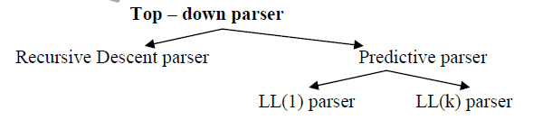
Top Down parsing categories
It finds a left most derivation for an input string or an attempt to construct a parse tree for the input, starting from the root to the leaves. Two types are : recursive & predictive.
RECURSIVE DESCENT PARSING
Recursive descent parsing is one of the top-down parsing techniques that uses a set of recursive procedures to scan its input.
This parsing method may involve backtracking, that is, making repeated scans of the input. Grammar transformations are used to avoid backtracking.

Slide 10
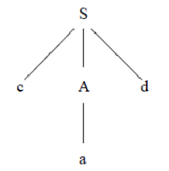
Difficulties/problems with top down parsing
Does not work in case of ambiguous grammar
Left recursion: In case of nonterminal it may get into infinite loop, in next example when A is expanded it again expand.
Backtracking: In erroneous expansions leading to mismatch, the semantic effects have to be removed. This is an overhead.
Can interpret wrongly as order in which alternatives are traced can affect language. In the next example parse tree for w=cad, since ab production is rejected for A, accepting sequence ‘cabd’ may not be possible.
Locating error points is not possible. Parser simply returns.
Dangling else problem creates ambiguity which parser can not resolve unless grammar is modified.

Slide 11
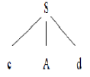
Recursive descent parsing
Example for backtracking :
Consider the grammar G : S → cAd
A → ab | a
and the input string w=cad.
Step1:
Initially create a tree with single node labeled S. An input pointer points to ‘c’, the first symbol of w. Expand the tree with the production for S.

Slide 12
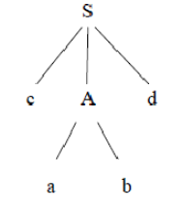
Recursive descent parsing : step2
The leftmost leaf ‘c’ matches the first symbol of w, so advance the input pointer to the second symbol of w ‘a’ and consider the next leaf ‘A’. Expand A using the first alternative.

Slide 13
Recursive descent parsing complete
Step3:
The second symbol ‘a’ of w also matches with second leaf of tree. So advance the input pointer to third symbol of w ‘d’. But the third leaf of tree is b which does not match with the input symbol d.
Hence discard the chosen production and reset the pointer to second position. This is called backtracking.
Step4:
Now try the second alternative for A in
A → ab | a, that completes parsing.
Try out:
W->cabd
Try: A-> XYZ

Slide 14
Top down: recursive descent method
Two disadvantages : backtracking and infinite loop (ex.expanding nonterminal A repeatedly)
Top-down parsing cannot handle left recursive grammars.
Try the below grammar for id + id *id with top down parsing method. (solution in the next slide)
E -> T E'
E' -> + T E ' | ϵ
T -> F T '
T ' -> * F T ' | ϵ
F -> (E) | id

Slide 15
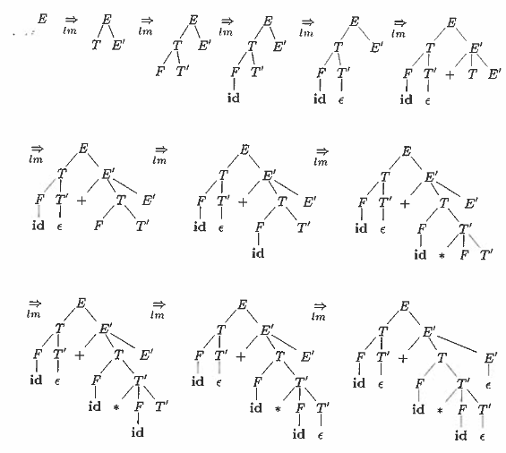
Top down parsing for id + id * id
Note: lm = Left most derivation

Slide 16
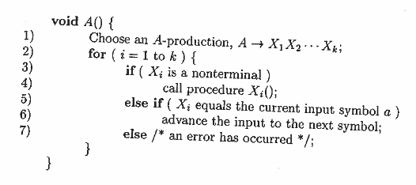
Recursive descent parsing algorithm for a terminal symbol

Slide 17
First & Follow
The construction of both top-down and bottom-up parsers is aided by two functions, FIRST and FOLLOW, associated with a grammar G. During top-down parsing, FIRST and FOLLOW allow us to choose which production to apply, based on the next input symbol. During panic-mode error recovery, sets of tokens produced by FOLLOW can be used as synchronizing tokens.

Slide 18
First & Follow (contd..)
Define FIRST(a), where a is any string of grammar symbols, to be the set of terminals that begin strings derived from a.
Define FOLLOW(A), for nonterminal A, to be the set of terminals a that can appear immediately to the right of A in some sentential form.

Slide 19
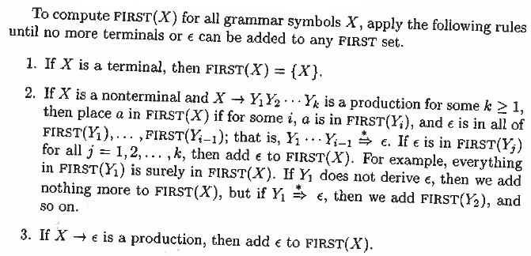
Computing FIRST set
*=> derives in zero or more steps

Slide 20
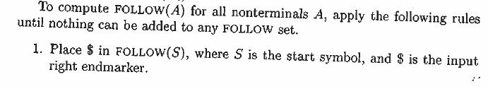
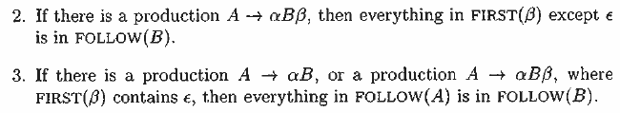
Computing the Follow set

Slide 21
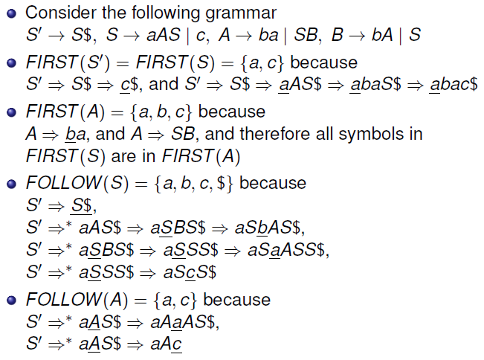
Example for First & Follow set

Slide 22
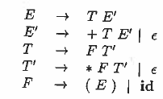
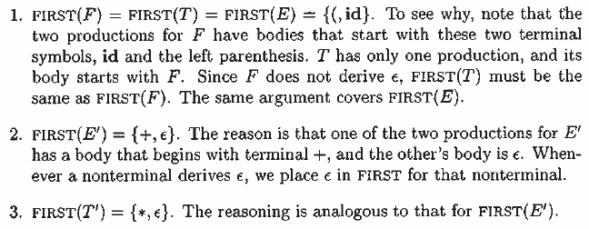
First & Follow Example
Consider the grammar:
Then:

Slide 23
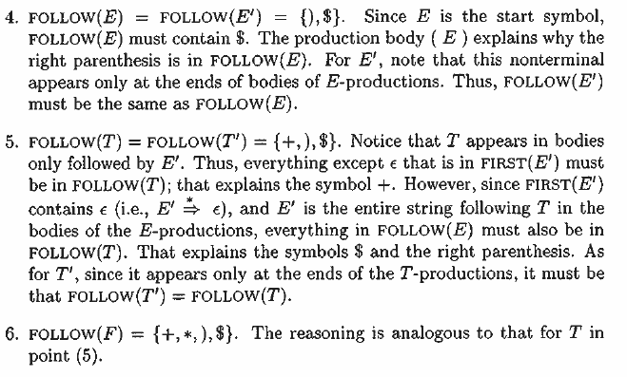
Example (contd..)
E’->+TE’
E->TE’

Slide 24
LL(1) grammar & Predictive parsing
Predictive parsers, that is, recursive-descent parsers needing no backtracking, can be constructed for a class of grammars called LL(1). The first "L" in LL(1) represents scanning the input from left to right, the second "L" for producing a leftmost derivation, and the " 1 " for using one input symbol of lookahead at each step to make parsing action decisions.
A left recursive or ambiguous grammar can NOT be LL(1).
Each parsing table entry uniquely identifies a production or signals an error.
Predictive parsing does not need backtracking.

Slide 25
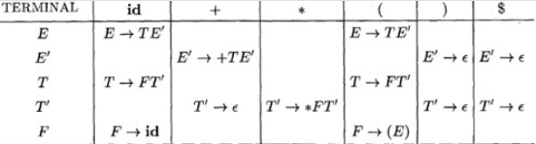
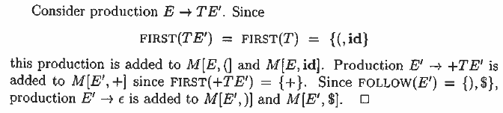
Predictive Parsing Table, M
FIRST(F) = FIRST(T) = FIRST(E) = {(,id}
FIRST(E') = {+, ϵ}. FIRST(T') = {*, ϵ}.
FOLLOW(E) = FOLLOW(E') = {),$}.
FOLLOW(T) = FOLLOW(T') = { + , ) , $}.
FOLLOW(F) = { + , * , ) , $ } .

Slide 26
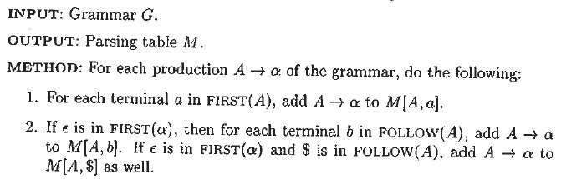

Algorithm for constructing Predictive Parsing (top down) Table

Slide 27
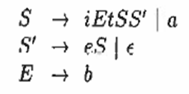
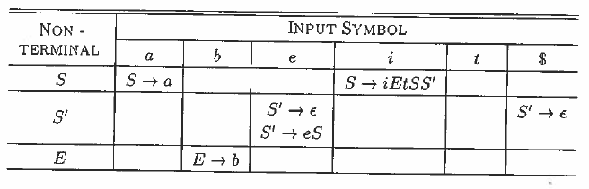


Dangling else problem has no LL(1) grammar: Illustration
FIRST(S)={a,i}, FIRST(S’)={e, ϵ}
FIRST(E) = {b}, FOLLOW(S’)={e,$} because it has αBβ form

Slide 28
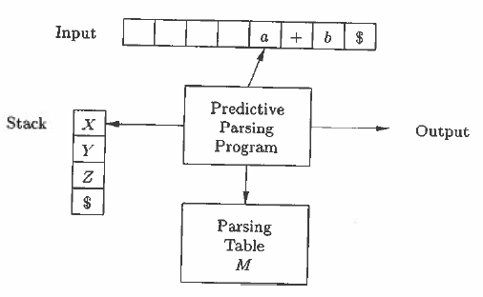
Model of a table driven predictive parsing
The input buffer contains the string to be parsed, followed by the endmarker $. Stack contains a sequence of grammar symbols, with symbol $ to mark its bottom. Stack entries are matched and if found match productions are sent as output.

Slide 29
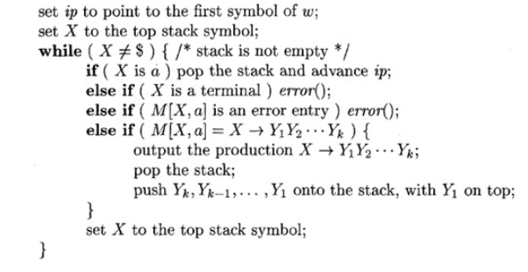
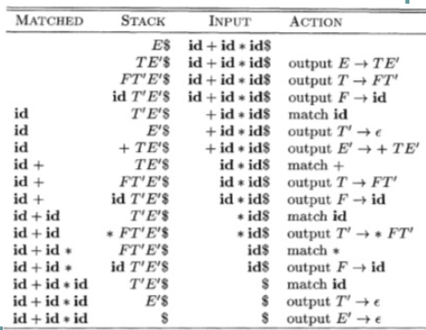
Predictive Parsing Algorithm
Algorithm
Moves for input string id+id*id

Slide 30
Predictive Parser: An Example
Stack | Input | Output
$E | id+id*id$
$E’T | id+id*id$ | E → TE’
$E’T’F | id+id*id$ | T → FT’
$E’T’id | id+id*id$ | F → id
$E’T’ | +id*id$
$E’ | +id*id$ | T’ → є
$E’T+ | +id*id$ | E’ → +TE’
$E’T | id*id$
$E’T’F | id*id$ | T → FT’
$E’T’id | id*id$ | F → id
$E’T’ | *id$
$E’T’F* | *id$ | T’ → *FT’
$E’T’F | id$
$E’T’id | id$ | F → id
$E’T’ | $
$E’ | $ | T’ → є
$ | $ | E’ → є
 | id | + | * | ( | ) | $
E | E→TE’ |  |  | E→TE’
E’ |  | E’→+TE’ |  |  | E’→є | E’→є
T | T→ FT’ |  |  | T→FT’
T’ |  | T’→є | T’→*FT’ |  | T’→є | T’→є
F | F→id |  |  | F→(E)
Parsing Table
Algorithm Trace →

Slide 31
Error recovery in Predictive parsing
An error is detected during predictive parsing when the terminal on top of the stack does not match the next input symbol or when nonterminal A is on top of the stack, a is the next input symbol, and M[A, a] is error (empty).
Panic mode error recovery is based on the idea of skipping symbols on the input until a token in a selected set of synchronizing tokens appears.
Phrase level error recovery is implemented by filling in the blank entries in the predictive parsing table with pointers to error routines.
Error productions included to detect anticipated errors
Global corrections: find parse tree and transform

Slide 32
Error recovery Details
Panic-Mode Recovery
With this method, on discovering an error, the parser discards input symbols one at a time until one of a designated set of synchronizing tokens is found. The synchronizing tokens are usually delimiters, such as semicolon or}, whose role in the source program is clear and unambiguous. The compiler designer must select the synchronizing tokens appropriate for the source language. While panic-mode correction often skips a considerable amount of input without checking it for additional errors, it has the advantage of simplicity, and, unlike some methods to be considered later, is guaranteed not to go into an infinite loop.
Phrase-Level Recovery
On discovering an error, a parser may perform local correction on the remaining input; that is, it may replace a prefix of the remaining input by some string that allows the parser to continue. A typical local correction is to replace a comma by a semicolon, delete an extraneous semicolon, or insert a missing semicolon. The choice of the local correction is left to the compiler designer. Of course, we must be careful to choose replacements that do not lead to infinite loops, as would be the case, for example, if we always inserted something on the input ahead of the current input symbol. Phrase-level replacement has been used in several error-repairing compilers, as it can correct any input string. Its major drawback is the difficulty it has in coping with situations in which the actual error has occurred before the point of detection.
Error Productions
By anticipating common errors that might be encountered, we can augment the grammar for the language at hand with productions that generate the erroneous constructs. A parser constructed from a grammar augmented by these error productions detects the anticipated errors when an error production is used during parsing. The parser can then generate appropriate error diagnostics about the erroneous construct that has been recognized in the input.
Global Correction
Ideally, we would like a compiler to make as few changes as possible in processing an incorrect input string. There are algorithms for choosing a minimal sequence of changes to obtain a globally least-cost correction. Given an incorrect input string x and grammar G, these algorithms will find a parse tree for a related string y, such that the number of insertions, deletions, and changes of tokens required to transform x into y is as small as possible. Unfortunately, these methods are in general too costly to implement in terms of time and space, so these techniques are currently only of theoretical interest. Do note that a closest correct program may not be what the programmer had in mind. Nevertheless, the notion of least-cost correction provides a yardstick for evaluating error recovery techniques, and has been used for finding optimal replacement strings for phrase-level recovery.

Slide 33
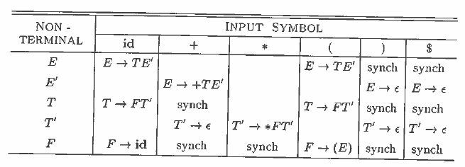
Error recovery example
With sync terms for error Without sync terms
"synch" indicates synchronizing tokens obtained from the FOLLOW set of the nonterminal in question.
If the parser looks up entry M[A,a] and finds that it is blank, then the input symbol a is skipped. If the entry is "synch" then the nonterminal on top of the stack is popped in an attempt to resume parsing. If a token on top of the stack does not match the input symbol, then we pop the token from the stack.
FOLLOW(E) = FOLLOW(E') = {),$} => synch placed here
FOLLOW(T) = FOLLOW(T') = { + , ) , $} => synch placed for these
FOLLOW(F) = { + , * , ) , $ } => synch placed for these
For error input: )id*+id will have recovery working

Slide 34
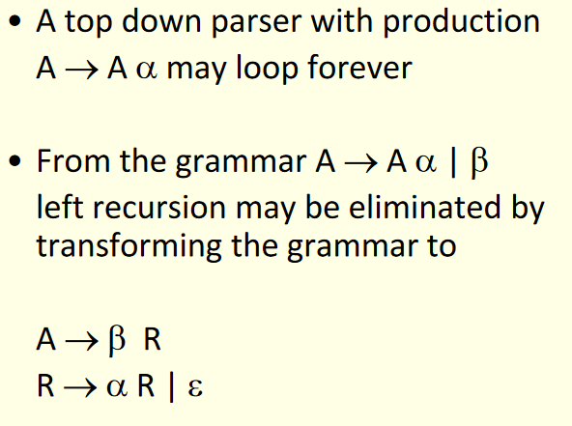
Left recursion & its elimination
This transformation is needed for top down parsing

Slide 35



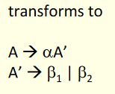
Dangling else & Left factoring to avoid it
It is a grammar transformation suitable for (top down) predictive parsing. Basic idea is: when it is not clear which of the two productions to expand, we can rewrite the productions so to make the right choice.
The "dangling-else" problem=>
Here, i, t, and e stand for if, then, and else; E and S stand for "conditional expression" and "statement." Left-factoring this grammar=>
Example :

Slide 36

Eliminating Ambiguity: dangling else
Dangling else grammar →
Rewrite to eliminate ambiguity
stmt -> matchedstmt | openstmt
matchedstmt -> if expr then matchedstmt else matchedstmt |
other
openstmt -> if expr then stmt
| if expr then matchedstmt else openstmt
The idea is that a statement appearing between a then and an else must be "matched"; that is, the interior statement must not end with an unmatched or open then. A matched statement is either an if-then-else statement containing no open statements or it is any other kind of unconditional statement. It then allows only one parsing for string.
Notes:
“match each else with the closest previous unmatched then”

Slide 37
Bottom up Parsing
A bottom-up parse corresponds to the construction of a parse tree for an input string beginning at the leaves (the bottom) and working up towards the root (the top).
It is convenient to describe parsing as the process of building parse trees, although a front end may in fact carry out a translation directly without building an explicit tree.
Avoids backtracking and is efficient.

